Slide 1


Airbnb Analysis & Price Prediction

Slide 2





Our Team
Michael Seibel
Dan Zhou
Urvi Vaidya
Sem Leontev
Soo Lee
Nishant Parate
Advisors

Slide 3
Our Team
Michael Seibel
Dan Zhou
Urvi Vaidya
Sem Leontev
Soo Lee
Nishant Parate
Advisors

Slide 4







Agenda
Problem Statement
Data Source
Data Cleaning
The business problem which is going to be resolved by this project
Web scrapped Airbnb listing data from opendatasoft.com
Removing Nulls and fabricating data.
Insights from Data
Predicting Price
Exploratory Data Analysis to find the useful information from data.
Using machine learning model to predict the price

Slide 5
Problem Statement
Airbnb Host’s unable to competitively price their new listing

Slide 6

Data Source
Web scraped Data
Location
Volume
The data is scraped from the Airbnb website and contain all the important attributes.
This data has information about all the listings in Los Angeles
This dataset has 19427 Rows and 89 columns

Slide 7

Removing Extra’s
Extra columns and nulls are removed
Data Cleaning
Populating Nulls
The original dataset contains lot of unwanted data & null. Hence, cleaning is required before deriving insights from data
Filling the null values with appropriate data
Transforming Data
Creating new columns from existing data

Slide 8

Removing Extra’s
Original Dataset has a lot of unwanted columns which are not useful, this steps removes all the unnecessary data.
Null Columns
Extra Columns
Null Rows
-47 Col’s
-6 Cols
-6953 Row’s
Removing Columns Like URL, image etc.
Removed columns with more than 50% null values
Removed Nulls with more than 6 null values

Slide 9
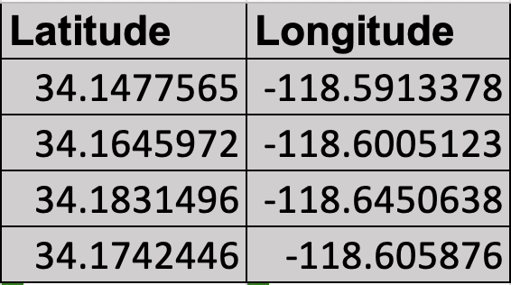
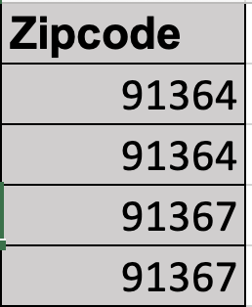
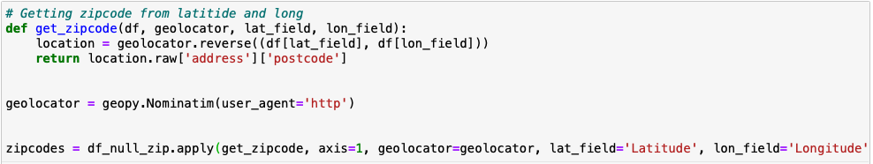
Filling Null
Even after removing most of the null values there are still a few null values that need to be handled, this step takes care of those null values
Geo Coordinates
Zip Codes

Slide 10
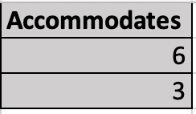
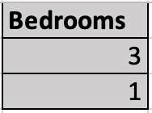
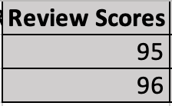
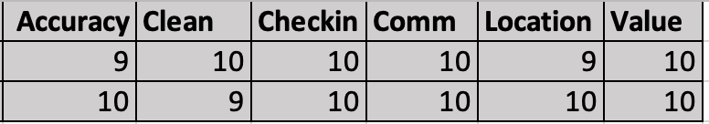
Filling Null
Even after removing most of the null values there are still a few null values that need to be handled, this step takes care of those null values
Accommodates
Number of Bedrooms
Review Score
Service Rating
Mean Cleaning Fees
Cleaning Fees

Slide 11
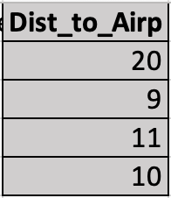
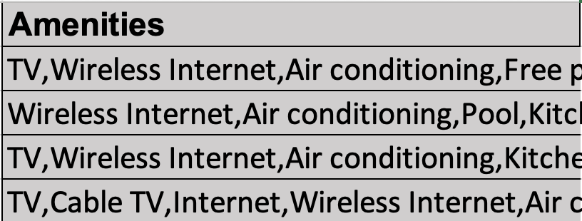
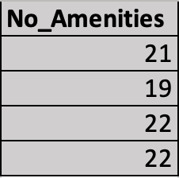
Transforming Data
After Filling nulls, the dataset had all the required values but to get insights from the data we need to transform the data.
Geo Coordinates
Distance to Airport
List of Amenities
Number of Amenities

Slide 12
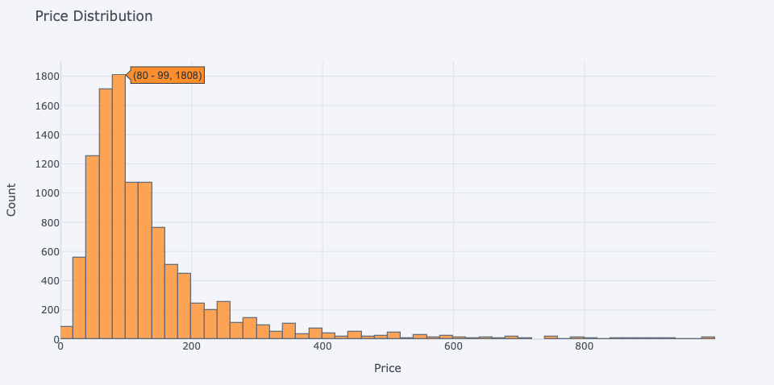
Insights from Data
Price Distribution

Slide 13
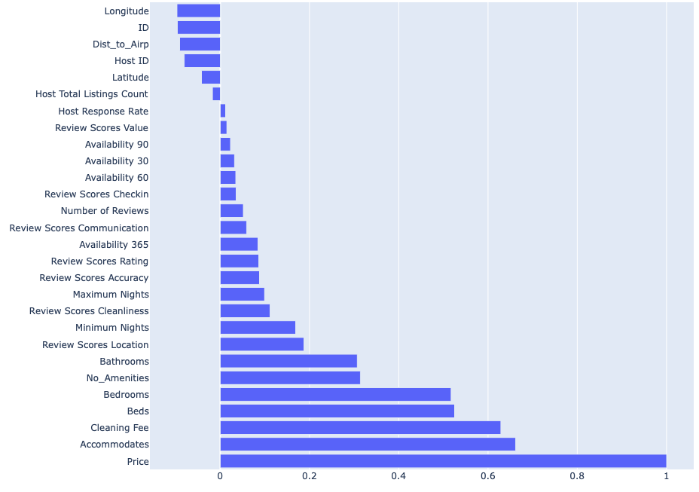
Factors Influencing Price

Slide 14
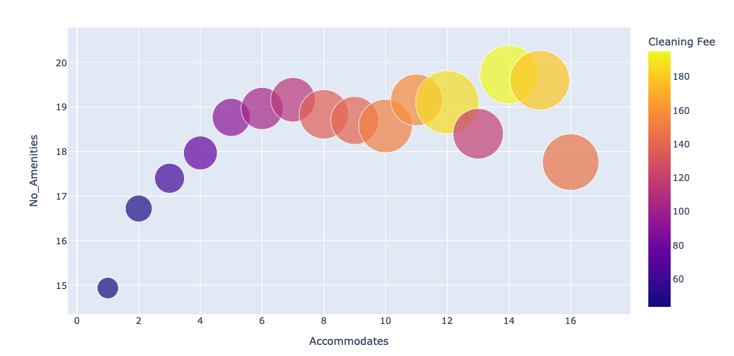
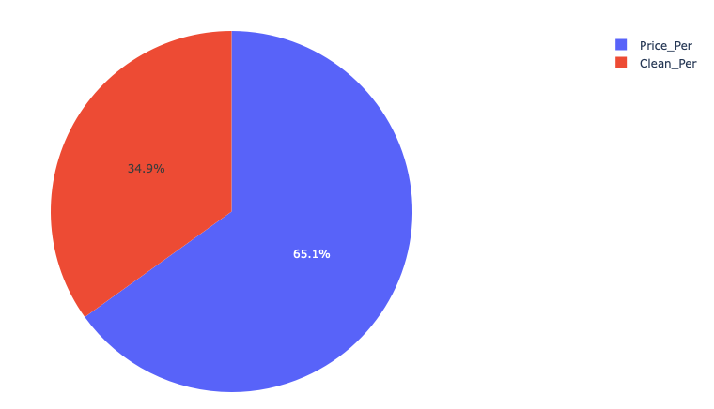
Relation of Price with important factors
The Size of the bubble represents the Price
The color of the bubble represents Cleaning Fees
The Pie chart shows the average percentage of cleaning fees that is charged out of total cost.

Slide 15
Relation of Price with important factors

Slide 16
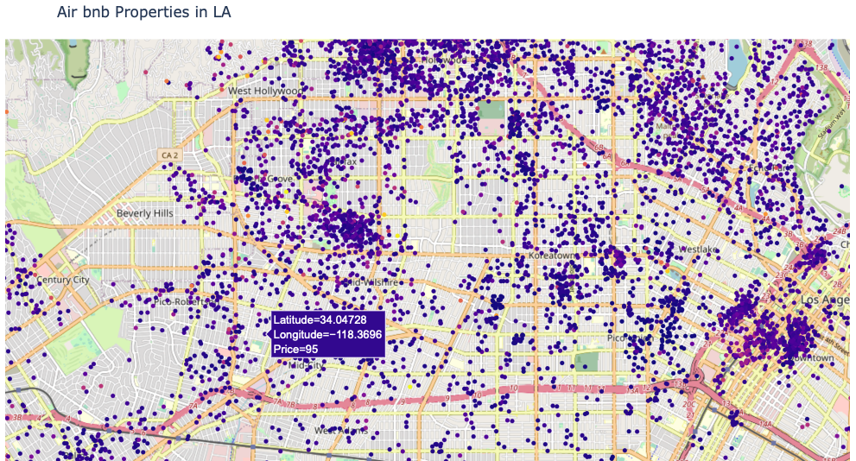
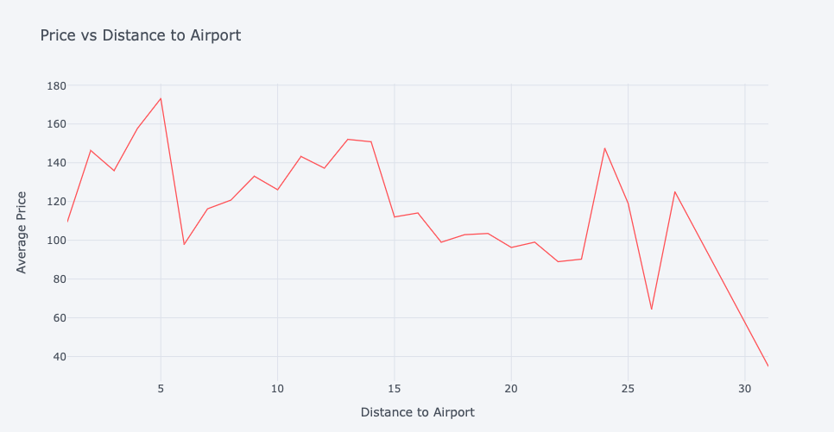
Relation of Price with Location
The map is interactive where you can zoom in to see price of a property
The average price of a property decreases with increase in distance from airport

Slide 17
Relation of Price with Location
The average price of a property decreases with increase in distance from airport

Slide 18
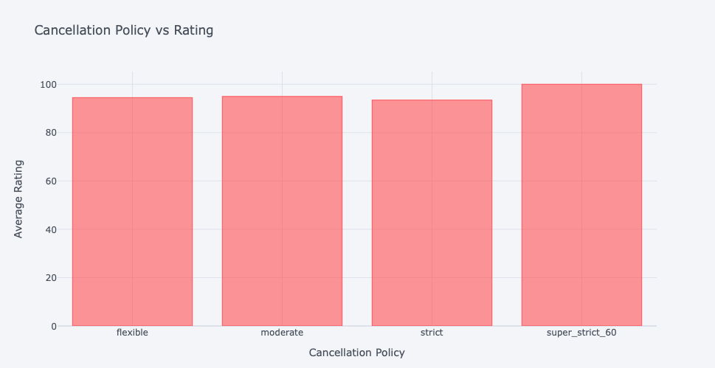
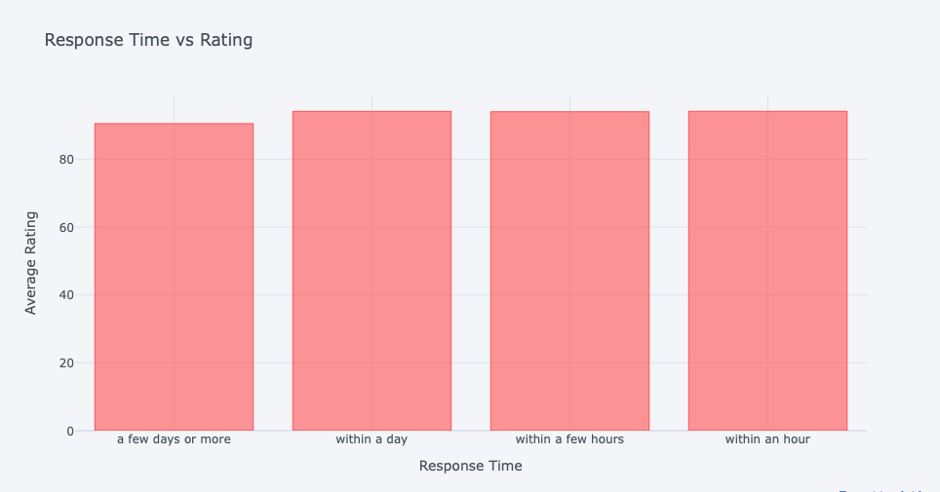
Factors Affecting Rating
The average rating for a property is higher if the cancellation policy is super strict.
People prefer host who respond within a day rather than hosts that take a few days to reply

Slide 19
Factors Affecting Rating

Slide 20
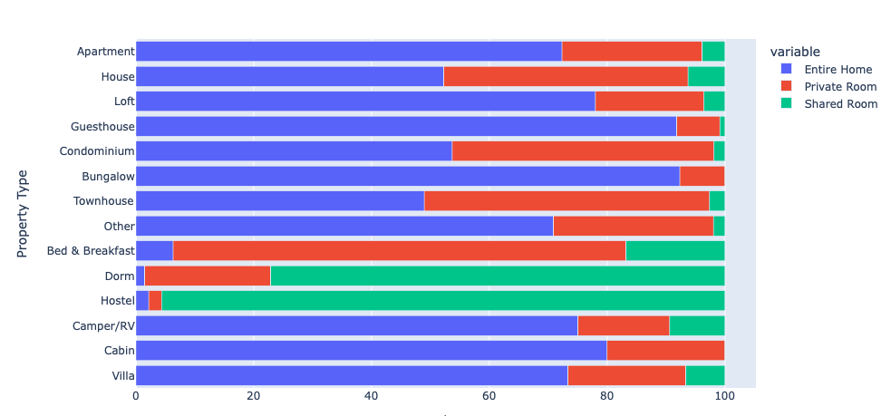
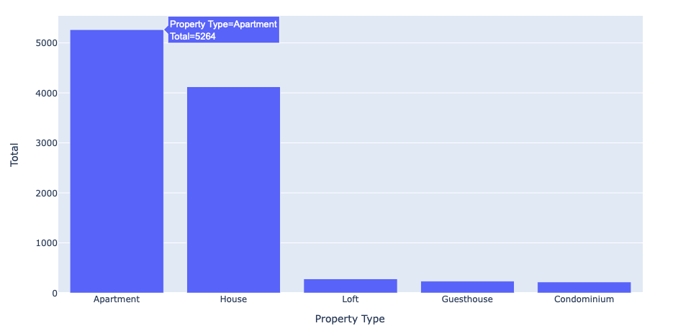
Market Analysis
The graphs helps us understand distribution of different types of room by property type
Apartment and House are the most common type of properties that are listed on Airbnb

Slide 21
Market Analysis

Slide 22
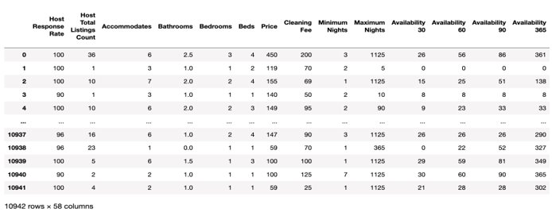
Machine Learning Algorithms
Continuous output, ['Price']
Decision Tree Regression
Linear Regression

Slide 23
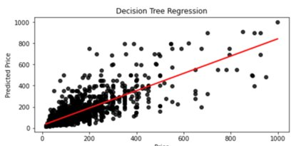
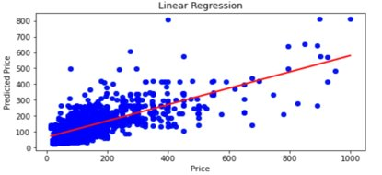
Benchmark with ALL Attributes
- R2: 57.71%.
- MAE: 41.3.
- RMSE: 71.88.
- R2: 51.40%
- MAE:50.48
- RMSE: 77.48

Slide 24
Bathrooms, Bedrooms, Cleaning Fee, Private room, Shared room
Accommodates, Bathrooms, Bedrooms, Cleaning Fee, Availability 90, Dist_to_Airp, Review Scores Location, House, Private room, Shared room
Feature Selection
K = 5
K = 10
R2: 44.43 %. 13.28% ↓
MAE: 45.65.
RMSE: 82.39
R2: 66.1%. 8.38% ↑
MAE: 36.95
RMSE: 64.35
Decision Tree Regression
R2: 67.93%. 16.53↑
MAE: 40.26
RMSE: 62.59
Linear Regression
R2: 70.26%. 18.86%↑
MAE: 38.41
RMSE: 60.27

Slide 25
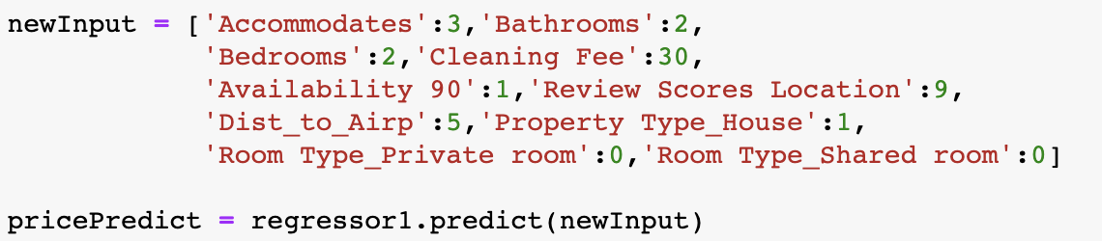
Predicted Price = $91
Predicting Price
Predicted Price = $91

Slide 26
Thank You,
Questions?

